Slide 1
CTC, Inc.
Feasibility Study for
Developing Regional E911 Communications Services
For Charlton, Oxford, Southbridge, Spencer and Sturbridge
Final Report Briefing
April 5, 2017

Slide 2
Agenda
Introduction of Project – Brian Palaia, Oxford Town Manager
CRECC Final Report Briefing – Tom Kennedy, CTC, Inc.
Practitioner Panel
Police Department perspective/benefits – Chief Thomas Ford, Sturbridge Police Department
Fire Department perspective/benefits – Chief Mark DiFronzo, Southbridge Fire Department
Dispatcher perspective/benefits – Penny Ryan, Charlton Lead Dispatcher
A Town Manager’s perspective/who has been through the process – Kevin Paicos
Q & A

Slide 3
Study Mission
To determine if the regionalization of the emergency communications for Charlton, Oxford, Southbridge, Spencer and Sturbridge is a practical, effective and economical endeavor for all communities

Slide 4
Methodology
Interviews
On-site Assessments
Analyze all aspects of current communications centers operations including technology, training and procedures
Assessed possible RECC sites to receive 911 calls and provide dispatch services to public safety agencies and units
Worked with CRECC Committee
Open and Transparent Process

Slide 5
Tasks
Task #1 – Completed an inventory of existing communications/IT equipment.
Task #2 – Identified and Compile Call Volume for each Community.
Task #3 – Determined the needed equipment and IT necessary to establish and standardize the CRECC.
Task #4 – Prepared a draft operating and capital budget for the CRECC.
Task #5 – Assisted with the identification of a CRECC location.
TASK #6 – Identified areas of Operational Improvement.
TASK #7 – Participated in Discussions w/ the Webster RECC to determine if Membership is Practicable.

Slide 6
Vision
The Vision of the CRECC model was to create a regional dispatch district that was solely focused on emergency communication services as a separate government entity located in a stand-alone facility that provided for the ability to expand its capability by fifty percent.

Slide 7
Interview Results Strengths/Potential Benefits
Enhanced Emergency Medical Dispatch (EMD) capability
Cost savings and greater efficiency
Sharing of services/coordination with other towns
Opportunity for regional grants
New Systems require strong technical skills
New innovations
Provide for consistency of services
Workload distributed among more dispatchers
More robust systems/center for major incidents

Slide 8
Interview Results Concerns
Information overload
Prisoner custody and care/lock up – Dark stations
Loss of dispatcher at window of police station
Less community oriented

Slide 9
Interview Results Important to Successful Integration
All towns to benefit equally
RECC to be located at a neutral site
Chiefs will need administrative support to replace services that dispatchers had been providing
Provide for transparency
Do not lay off current dispatchers
Meet with community dispatchers
Involve dispatchers in the transition process

Slide 10
Interview Results Important to Successful Integration
Ensure a transition process occurs for the work done by dispatchers for officers
Technology integration
Plan for a robust center to accommodate major events and call surge
Locate Fire District 7 radio at CRECC
Plan for outreach to employees and the public/Demystify regional centers

Slide 11
Findings
Current Public Safety Answering Points (PSAPs) are primarily staffed by one dispatcher
Most dispatch center equipment and radio systems are outdated and will need to be need of replacement within five years
All five communities have effective leadership
All five communities are very much alike in terms of geography and make up
All five communities have been able to establish a common vision for a RECC that will meet their needs
A location was identified at the Woodard School to meet their current and future needs for a RECC
It is feasible to regionalize the emergency communications and dispatch services for the five communities

Slide 12
Regional Emergency Communications Dispatch District
Established by MGL Chapter 6A Section 18P
Regional District Board of Directors
Operations Committee
A Regional Municipal entity to meet the public safety needs of member communities

Slide 13
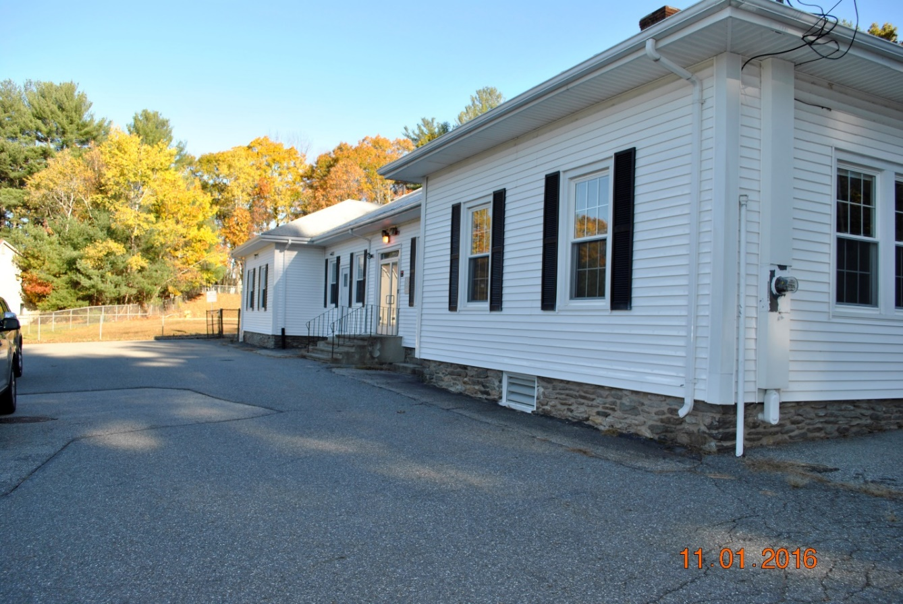
Potential Site – Woodward School

Slide 14
Community Distribution Cost Sharing
Community | 911 Call Volume | 911 Calls % | Population | Population% | 50% 911 Calls 50% Population
Charlton | 2,648 | 17.86% | 12,981 | 20.17% | 19.015%
Oxford | 2,700 | 18.20% | 13,709 | 21.30% | 19.75%
Southbridge | 4,504 | 30.37% | 16,719 | 25.98% | 28.175%
Spencer | 2,582 | 17.41% | 11,688 | 18.15% | 17.41%
Sturbridge | 2,396 | 16.16% | 9,268 | 14.40% | 16.16%
TOTAL | 14,830 | 100.00% | 64,365 | 100.00% | 100.00%

Slide 15
Community Recurring Cost Analysis
Community | Participation Ratio | Current Budget | New Assessment | Cost Savings
Charlton | 19.015% | $272,601 | $239,327 | $33,142
Oxford | 19.75% | $394,519 | $248,578 | $145,941
Southbridge | 28.175% | $420,472 | $354,617 | $65,855
Spencer | 17.78% | $290,189 | $223,783 | $66,406
Sturbridge | 15.28% | $364,867 | $192,318 | $172,550
TOTAL | 100% | $ 1,742,648 | $ 1,258,623 | $ 483,895

Slide 16
Community Cost Savings Summary
Annual Recurring and Capital Costs

Slide 17
State 911 Department Grant Funding Recurring Costs
FY17 Support Funds
Charlton $36,305
Oxford $39,070
Southbridge $44,952
Spencer $36,280
Sturbridge $29,006
Total $185,613
FY 18 CRECC Funds
Support $187,666
Incentive $410,000
Total $597,666

Slide 18
Changes within Emergency Communications
New Technology
Mapping
Wireless location
Next Generation 911
Receipt of information from social media, video images and other electronic systems
FirstNet
To provide emergency responders with high-speed, wireless broadband network
Enhanced Operational Standards
Emergency Communications operations and personnel are a new public safety profession

Slide 19
State 911 Department Role
Committed to more effective and economical 911 System
Reduce the number of stand alone Public Safety Answering Points (PSAPs) – 134 receive ten or fewer 911 calls per day
Strong funding stream – wireless surcharge
RECC
Incentive funds
Development Grants - Construction/facility rehabilitation, design, equipment including radio systems and security measures
Ongoing equipment replacement support

Slide 20
Recommendations
Consolidate the CRECC communities into a new entity, the Central Regional Emergency Communication Center (CRECC) that would be structured as a Regional Dispatch District. Purpose:
Enhance the emergency communication services provided to the CRECC communities, their citizens and their public safety departments
Provide for a more robust emergency medical dispatch (EMD) capability through the CRECC
Provide for cost savings to all communities through greater economy of scale
Shift the cost of future replacement of communication equipment at the individual community based dispatch centers from the communities to the State through the regional center

Slide 21
Recommendations
Leverage the capability of an RECC to enhance Emergency Medical Dispatching services.
Develop the CRECC at the Woodward School, 660 Main Street, North Oxford.
Develop an outreach program to all of the communities to inform the citizens of the five communities and their public safety personnel of the timelines for the potential changes, the rationale for the change and the benefits to them in the form of enhanced services.
Develop a Dispatch Manual to document the common operational policies and procedures that meet the unique needs of the disciplines of the emergency response agencies.

Slide 22
Recommendations
Seek State 911 RECC Developmental Funding for the CRECC, through the Town of Oxford, to convert the selected site into a state-of-the-art emergency communication center. Includes:
Conversion of Oxford’s Woodward School into the CRECC.
Radio communications interoperability between the CRECC and the police and fire departments of all five communities.
Enhanced security for the current community Public Safety Facilities during the times when the facility may not be staffed.

Slide 23
Recommendations
State 911 Funding (continued)
Dispatch consoles and furniture.
An administrative phone system between the CRECC and the community police and fire stations.
Fiber Optic connection between the CRECC and the CRECC community police and fire stations.
Transitional Training.

Slide 24
Recommendations
Develop a Dispatch Manual to document the common operational policies and procedures that meet the unique needs of the disciplines of the emergency response agencies to ensure the appropriate resources are provided at the time they are needed.
Finalize a plan to regionalize lockups between the five communities to utilize two of those current sites for this purpose.

Slide 25
Recommendations
Develop a plan for each community to provide the administrative support that the dispatchers have been providing. Strategies should include:
Provide administrative support during certain hours of the day during the week to support this effort with either full-time or part-time employees.
Schedule hours for those administrative functions and inform the public.
Review the administrative functions that could be put online through the internet, such as the Burn Permit system, to save processing time and to improve efficiency

Slide 26
Benefits to the Communities
Improved and standardized emergency communications and dispatching services
Provide for a more robust center with multiple dispatchers on duty each shift
Enhance Emergency Medical Dispatching
Greater capability for major incidents
Allows for municipal solution with like communities to a problem from a changing environment for emergency communications

Slide 27
Benefits to Communities
Dedicated 911 funding stream
Recurring cost are supported by State 911 Department incentive grant program for personnel and other operational expenses
Capital equipment and technology costs reimbursed by State 911 Regional Development program
Cost savings with long term economies of scale

Slide 28
Other Information Provided
Process to create a Regional Dispatch District
Draft Inter-Municipal Agreement
Site Comparison Analysis
Current equipment/technology inventory
Step by Step Process to Create CRECC
Transition Process
Staffing and Analysis
Cost Benefit Analysis
CRECC Facility Analysis

Slide 29
Next Steps
Approve and Sign the Inter-municipal Agreement
Seek State 911 Development Grant funds
Appoint a Building Committee
Appoint a District Board of Directors
Appoint an Operations Committee

